Slide 1


Slide 2


Table of contents
1 – What SEALFAIL is and is not (2 slides)
2 – Target users (3 slides)
3 – Main features (6 slides)
4 – Technical outlook (6 slides)

Slide 3
What SEALFAIL is and is not

Slide 4
What SEALFAIL is
SEALFAIL is a free and open source workstation operating system based on Alma Linux.
SEALFAIL is hardened/secured out-of-the-box and ready for use immediately after installation.
SEALFAIL is a tool to help organizations meet higher COMSEC/INFOSEC/OPSEC standards.
SEALFAIL is built with specific use cases in mind and will only serve those use cases.
SEALFAIL can and should be customized by your organization to include its own modifications and suit its specific use cases.

Slide 5
What SEALFAIL is not
SEALFAIL is not a general-purpose OS like Qubes.
SEALFAIL is not a "hacktivism" tool designed for offensive action.
Additional software cannot be installed on top of SEALFAIL.
SEALFAIL is not a single solution to all security problems. OPSEC doesn't end at operating system selection.

Slide 6
Target users

Slide 7
Target users - 1/3
Non Governmental Organizations (NGOs)
Examples: An NGO field operator investigating the human rights violations taking place within the territory of Yemen in the context of the Yemeni civil war might use SEALFAIL on their device to secure their data in the event of confiscation or interference from states and militias.

Slide 8
Target users - 2/3
Activists and political dissidents
Examples: Activists might use SEALFAIL to organize between groups spread across the country and help ensure their OPSEC/INFOSEC/COMSEC standards are met.
SEALFAIL helps put activists on an equal footing against surveillance states and authoritarian regimes.
SEALFAIL becomes a powerful tool to increase the activist projection capabilities and the scale of their operations.

Slide 9
Target users - 3/3
Militias and underground activists
Examples: Underground groups in conservative parts of the United States working to provide safe abortions to women that would otherwise be illegal under local jurisdiction.
Ukrainian partisans engaged in direct action against the Russian invasion.

Slide 10
Main features

Slide 11

Main features - 1/6
Fast mastering process
The SEALFAIL installation process is fully automated, only requiring selection of the system's language, keyboard layout, and timezone before proceeding with a zero-click installation process.
+ Customizable installation process
+ Significant time saving
+ No technical knowledge required

Slide 12
Main features - 2/6
Discardable hardware
A SEALFAIL installation image will produce the exact same system on all devices it is installed to.
The system is read-only and fully volatile.
Permanent storage is delegated to a single LUKS-encrypted qcow2 disk image, the content of which is served by a host-only virtual machine over CIFS, making this file the only difference between two installations of SEALFAIL.
+ Quickly replace and upgrade user hardware
+ Reduce user downtime
+ No user re-training required

Slide 13
Main features - 3/6
Repeatability and hardware abstraction
As all systems are strictly identical and volatile, replacing or upgrading devices is a matter of minutes that requires no re-training of the end user and ensures a common user experience on all devices.
This saves on cost and time, both of which target users often cannot afford.
+ Shutting down the machine brings it back to its factory state
+ Shared experience between users
+ Hardware interoperability

Slide 14






Main features - 4/6
Prepackaged software
SEALFAIL comes with a plethora of pre-packaged software, all pre-configured and containerized to ensure security standards.
The pre-packaged software collection includes common cryptographic tools, communication utilities and the LibreOffice suite among many other.
+ No time wasted mastering software
+ No time wasted securing software
+ More time spent using quality software

Slide 15
Main features - 5/6
Deep hardening
All of the software that comes pre-packaged with SEALFAIL runs in its own LXC container.
State-of-the-art security tools are used to ensure the system is secured to US DoD STIG compliance.
SEALFAIL leverages the full power of hardware cryptography and modern access-control techniques to ensure security on all levels of execution.
+ Volatile containers ensure system integrity
+ Scheduled checks ensure the device has not been compromised
+ Hardware cryptography ensures a chain of trust from startup

Slide 16
Main features - 6/6
Kill switch
SEALFAIL comes with a built-in kill switch to destroy the permanent storage in case of a security incident.
The kill switch can only be triggered manually by the user.
+ Prevent secret leaks
+ The kill switch cannot be remotely triggered
+ The permanent data is physically erased from the device

Slide 17
Technical outlook

Slide 18

Technical outlook - 1/6
Based on Alma Linux
SEALFAIL is based on Alma Linux, a community owned, forever-free version of Red Hat Enterprise Linux (RHEL).
Entirely compatible with the Enterprise Linux (EL) ecosystem, SEALFAIL is based on tried and trusted technologies that have been industry standards for years.

Slide 19
Technical outlook - 2/6
Kickstarts & built-in RPM repositories
SEALFAIL is automatically installed using a kickstart file bundled with the installation image.
The kickstart file can be customized to deploy customized SEALFAIL installations.
The installation image also contains a bundled RPM repository with all the extra packages required by SEALFAIL.

Slide 20



Technical outlook - 3/6
OpenSCAP & AIDE
OpenSCAP is used to harden the system to US DoD DISA STIG GUI compliance.
AIDE is used to check the system's integrity and detect changes that would result from an intrusion into the system.
Scheduled OpenSCAP compliance checks and AIDE integrity checks are performed at regular intervals using systemd timers.

Slide 21
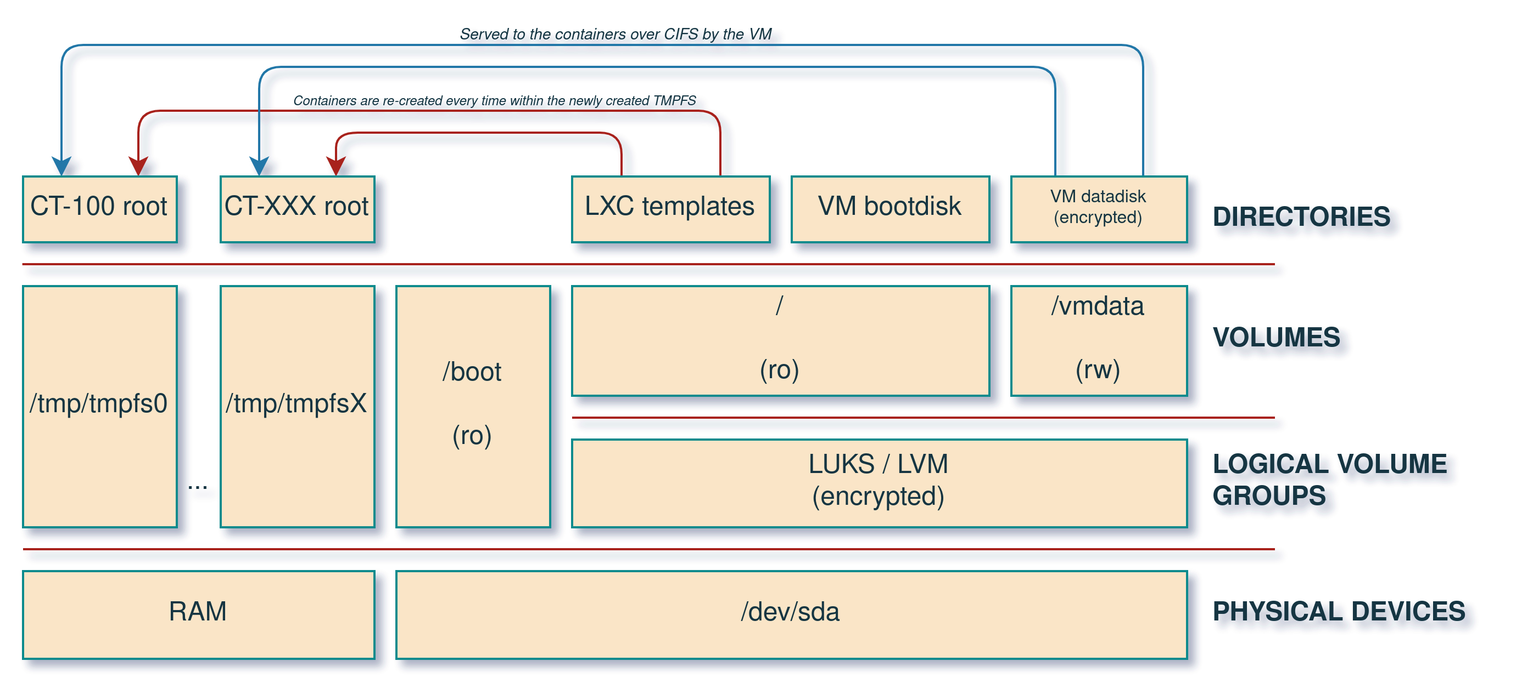

Technical outlook - 4/6
All software runs under LXC
The bundled software cannot be launched directly. It is instead spawned in Linux containers (LXC) running from TMPFS to ensure volatility.
Each software instance is completely isolated from the others.

Slide 22

Technical outlook - 5/6
Virtualized permanent storage
Permanent storage is delegated to CIFS shares.
The shares are served to the device from a qemu VM.
The VM has a read-only bootdisk, and a write-enabled datadisk located on its own host partition. The datadisk is used for the CIFS shares.
The datadisk is encrypted and requires a user secret to be decrypted.
The shares are served to the LXC containers with strict access control.

Slide 23

Technical outlook - 6/6
Custom kernel
Run-time module loading is disabled.
The kernel is built with only the required modules, drastically decreasing its attack surface.

Slide 24
https://sealfail.org
contact@sealfail.org

